Slide 1
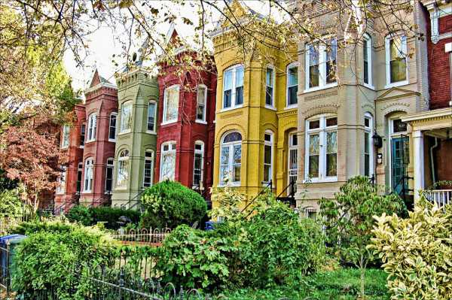
Leo’s House Hunt
Freguenet
Dan Hong
Derek Denning
Mike George

Slide 2
Motivation and Summary
Leo is becoming increasingly frustrated by our basic github questions and ready to retire from coding. He’s intrigued by Washington DC real estate and looking for where best to buy?
Objective: Where and what to buy for an optimal return in 10 years assuming current market conditions remain stable
Question: Is there a clear quadrant, or ward that is poised to deliver superior investment returns over the next 10 years?

Slide 3
Questions & Data
We used the D.C. Residential Properties dataset from Kaggle as our sole dataset.
We needed key data parameters that would provide insight into a quadrants or wards investment prospects. Some of the data was numerical (sale px, transaction count) while others were qualitative (city quad / ward). Some of the key function we used to cut our data included groupby, .mean, .count, .agg, .loc. Important parameters in our data include:
Price Year built Building type
Sale Date Bedrooms Square feet
Location (quad/ward) Remodel Year

Slide 4
Data Cleanup & Exploration
We spent most of last Saturdays class just exploring to understand what parameters were available to analyze.
Key Insights:
Upwards of half of the 158,000 records didn’t include price data
Commercial properties included in the “Residential” dataset severely skewed our findings and needed to be removed.
Data prior to 1992 was too sparse to be meaningful and needed to be removed
When all was said and done, we were left with third of the original data ~58,000 rows

Slide 5
Data Complication
Sale date was a key data point that the project was predicated on
Key Insights:
Upwards of half of the 158,000 records didn’t include price data
Commercial properties included in the “Residential” dataset severely skewed our findings and needed to be removed.
Data prior to 1992 was too sparse to be meaningful and needed to be removed
When all was said and done, we were left with third of the original data ~58,000 rows

Slide 6
Difficulty and Resolutions
We initially discussed what we wanted to answer before exploring the data.
Once we explored the data and learned the dataset wasn’t a vast oasis of interesting findings …we needed to regroup as a team and come up with plan B.
Worse, as a group, our data exploration evolved into us working on different aspects of the data.
We resolved this by having frequent touch points to report finings and ensure we were all marching towards the goal of having something presentable

Slide 7
Additional Questions to Explore
It would have been interesting to look at the impact additional parameters such as acreage, house condition, year built, # of fireplaces have on price
If we were to extrapolate historical returns forward (with regressions) what would that look like?
We would have liked to overlay additional datasets such as crime and walkability scores to ensure Leo remains safe and gets his steps in

